Slide 1

Smart Doorbell Camera System
Daniel Franco, Gonçalo Santos, Sofia Avelino, Breno Marrão

Slide 2
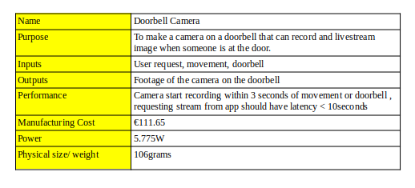
Project goals and specification

Slide 3
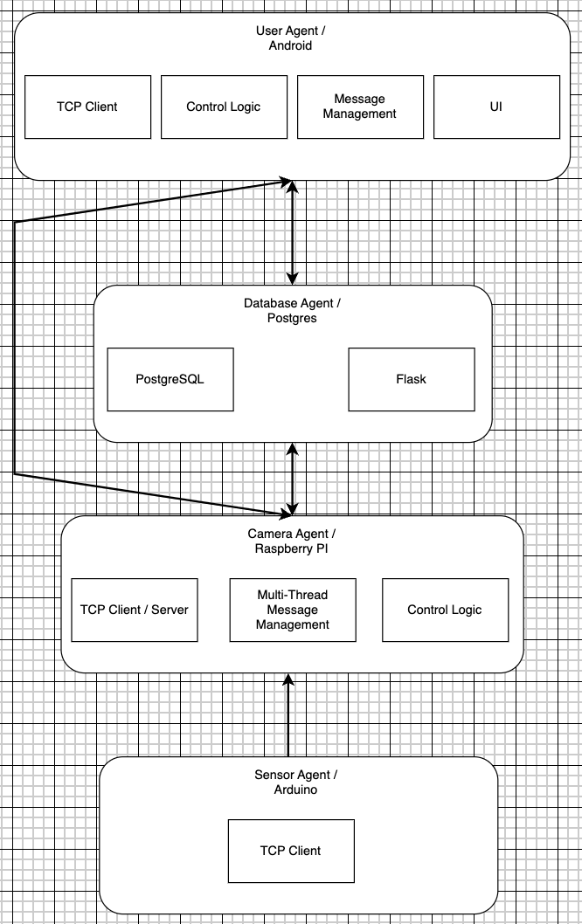
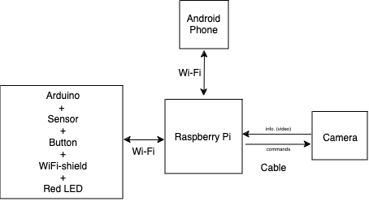
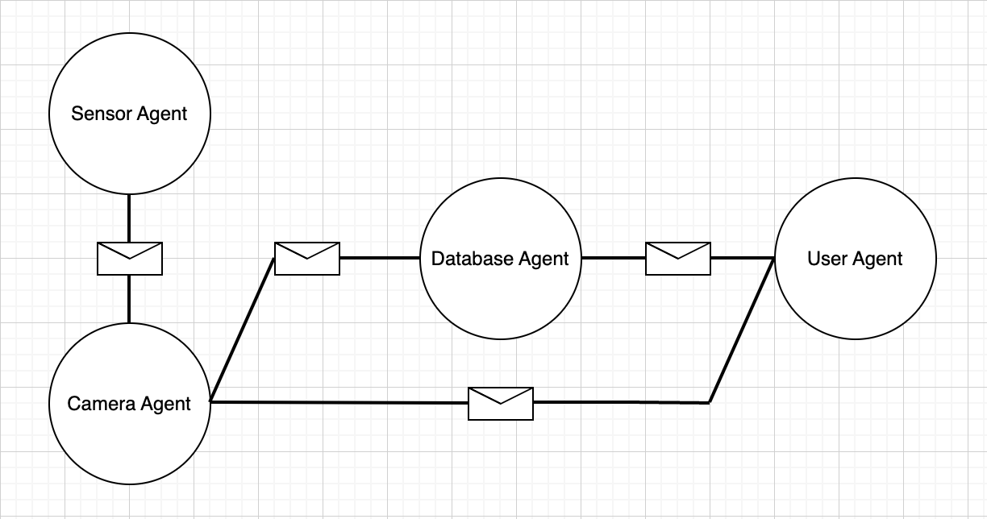
General Architecture

Slide 4
DEMO

Slide 5
Q&A

